Slide 1
Serious gaming helps children view Highway Code from another perspective
Anthoula Alipasali
Anton Eliens
Vrije Universiteit Amsterdam

Slide 2
Categories
Introduction
Serious games and education
Knowledge types
Knowledge process
Highway Code game
Significant benefits
Wireframes and actual app
Dissemination of the game

Slide 3
Serious games
Serious games:
Refer to digital games used for purposes other than mere entertainment.
They simulate environments and systems
Allow learners to experience cases that are not possible in real life

Slide 4
Serious games
Three main reasons that Serious games are used:
Safety
Cost
Time

Slide 5
Serious games
Is Serious gaming familiar to children?
The Federation of American Scientists suggests that kids from 8 to 18 years old usually spend approximately 50 minutes per day playing video games [3]

Slide 6
Serious games and education
A knowledgeable pedagogue transmits the knowledge to learners via:
Lectures
Books
Articles

Slide 7
Serious games and education
Limitations in the traditional learning paradigm:
Teaching is an indispensable condition for learning
The ultimate testing and skill acquisition and knowledge are not usually for knowing
Emphasize the transmission of knowledge from an acknowledged special to individuals in isolation

Slide 8
Serious games and education
Learning only what a person intends is not the most desirable
The physical layout of classrooms and the structure of classes transfers meta-messages about knowledge creation, acquisition and use.
Small capacity to accommodate linkages between affective, behavioral, and cognitive domains [7]

Slide 9
Serious games and education
Dissemination of gaming
Engaging educational practices
Worldwide use of the Internet
A paradigm shift, offered by serious gaming, which show us how the education and training should be delivered in the 21st century

Slide 10
Knowledge types
Communication knowledge
Situated knowledge
Tacit knowledge
Imperative knowledge
Explicit knowledge
Embedded knowledge

Slide 11
Knowledge processes that are supported
Hand and eye co-ordination
Spatial awareness
Memory and lateral thinking
Cognitive thinking
Self – assessment and analysis
Spatial abilities
People, job-specific, organization, communication, and strategy skills

Slide 12
Highway Code game
The Highway Code serious game is developed to teach children the highway code.
Children have much less limited attention span than the adults.
Children will be able to exercise, learn the signs, and having fun at the same time

Slide 13
Highway Code game
Is built for iPhone devices (ios 6 )
Portrait mode
Appcelerator Titanium is used for building the app

Slide 14
Significant benefits of Highway code game
Situated knowledge
Tacit knowledge
Embedded knowledge that is locked in processes
Hand - eye co-ordination
Spatial awareness
Memory and lateral thinking
Cognitive thinking
Self- assessment and analysis

Slide 15
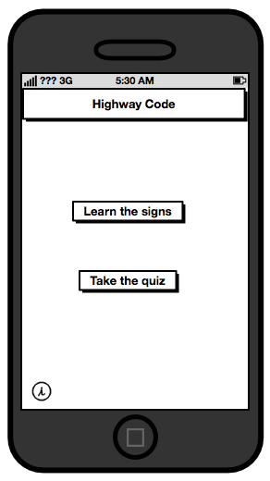
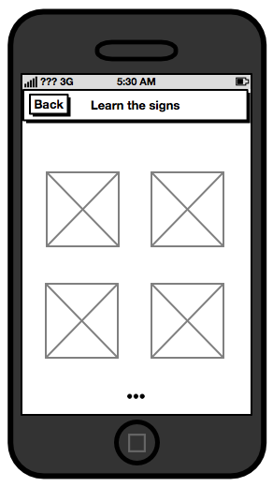
Wireframes
Main window
“Learn the signs” window

Slide 16
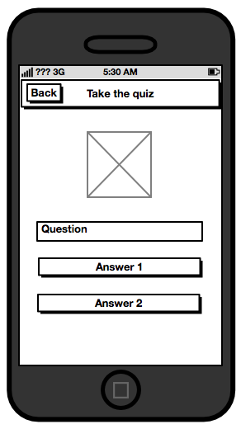
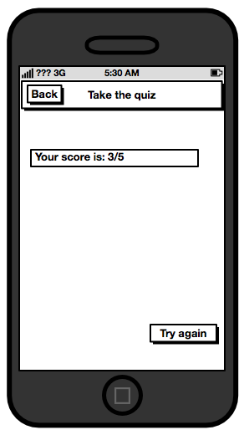
Wireframes
“Take the quiz” window
“Quiz results” window

Slide 17
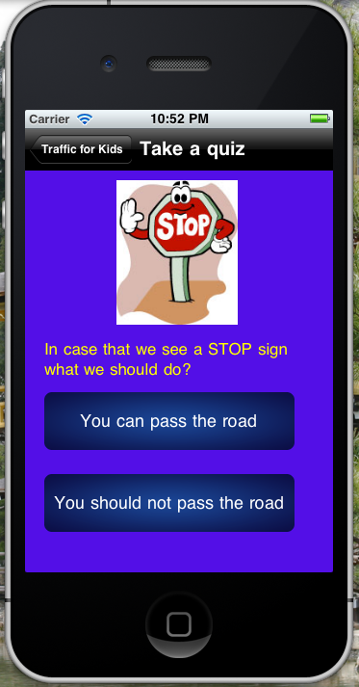
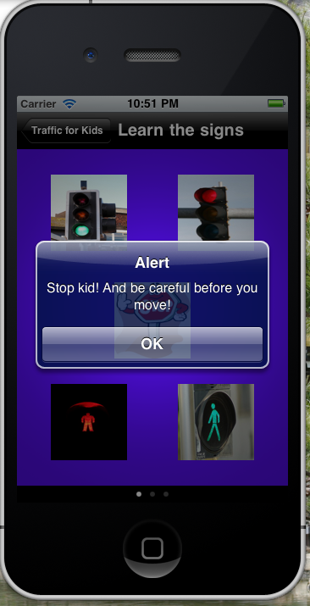
Highway code
“Take a quiz” window
“Learn the signs” window

Slide 18
Dissemination of the game
Free of charge application
Focus on schools
Focus on parents
Persuade teachers and parents about the importance of that application
Use social networks

Slide 19
References
[1] Bates A. W. T. 2005. “Technology, e-learning and distance education” .
[2] Gredler M. E. 2009. “Games and Simulations and their relationships to e-learning”. University of South Carolina,
[3] Derryberry A. 2007. “Serious games: online games for learning”.
[4] Kaiser family foundation, available at <http://www.kff.org/entmedia/entmedia012010nr.cf>
[5] Cole et al. “Color Psychology: Children vs. Adults”
[6] Definition of Learning, available at <http://en.wikipedia.org/wiki/Learning>
[7] Ruben B.D. 2002. “Simulations, games, and Experience-Based Learning: The new Quest for a New Paradigm for Teaching and Learning.” Rutgers University
[8] Freitas S. and Liarokapis F. “Serious Games: A new Paradigm for Education”. Coventry University.

Slide 20
Questions ?

